Slide 1

Real-Time Multi-Person Opt-in Camera System
Complete Flow Diagram and Implementation Details

Slide 2

Method Summary: Bridging Asynchronous Data
Data Fusion Challenge
UKF as Temporal Bridge
Integrating sparse 3 FPS UWB localization with high-rate 30 FPS camera tracklets in real-time.
Dedicated Unscented Kalman Filter for each UWB tag upsamples to 30 FPS with uncertainty weighting.
Probabilistic Matching
Optimal Assignment
Mahalanobis distance calculates similarity between UKF position and camera observation over sliding window.
Linear Assignment Problem solver finds best one-to-one match between all UWB tags and camera tracklets.
The system achieves robust, real-time person identification by decoupling high-rate tracking (UKF at 30 FPS) from lower-rate identification (LAP at 10 FPS), optimizing both latency and stability.

Slide 3
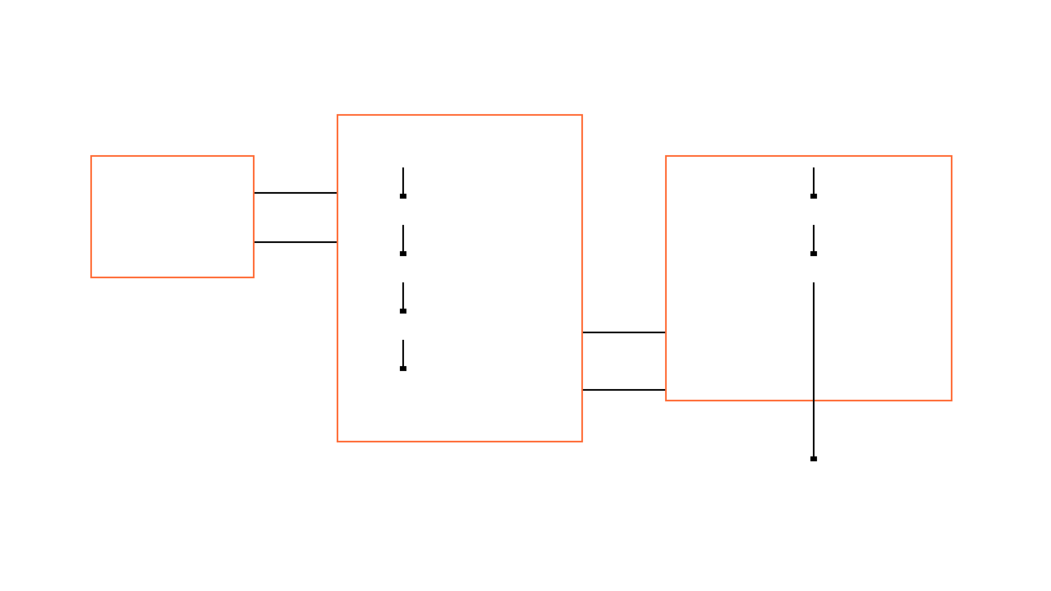
Complete System Flow Diagram
Multi-Person Tracker (30 FPS)
Data Sources
MultiPersonTracker
Trajectory Matching (10 FPS)
Camera Tracklets (30 FPS)
Calculate Mahalanobis Cost Matrix
UKF Prediction (All Tags)
UWB Measurements (3 FPS)
Solve LAP (Hungarian Algorithm)
UKF Update (UWB-Driven)
Optimal Assignment (UWB ID -> Tracklet ID)
UKF State Buffer (30 FPS)
UKF States (Pos + Cov)
Camera Tracklet Buffer
Tracklet Data
Assignment (10 FPS)
Final Identified Persons (10 FPS)
Visual representation of the real-time inference pipeline executed every frame (30 FPS). Data flows from asynchronous sources through multi-person tracking to final identification (10 FPS).

Slide 4

Implementation: Multi-Person Tracker
Class Overview
Operational Flow
Class Name
predict_all(frame, timestamp)
→
MultiPersonTracker
Runs for all active UKF instances
→
Executes every frame (30 FPS)
→
Core Structure
Dictionary of StreamingUWBUKF2D instances, keyed by UWB ID (101, 102, ...)
update_all_uwb(uwb_measurements)
→
Updates only when UWB data available
→
Corrects predicted state with measurement
→
State Vector (4D)
s = (x, v_x, y, v_y)
Position + Velocity
Occlusion Handling
When person leaves frame, UKF continues predicting. Covariance grows, reflecting increased uncertainty. Identity maintained until re-entry.
UWB Update Trigger
Only when new UWB measurement arrives (3 FPS). Uses UWB position as observation.
Each UWB tag maintains its own UKF instance, enabling independent, parallel tracking of multiple persons with automatic identity preservation during occlusions.

Slide 5

Implementation: Real-Time Matching
Matching Rate
Mahalanobis Distance
Runs at 10 FPS (every 3 frames) to reduce computational load and increase temporal stability.
D = √[(p_uwb - p_cam)ᵀ × Σ⁻¹ × (p_uwb - p_cam)]
where:
• p_uwb = UKF position
• p_cam = Camera position
• Σ = UKF covariance
Sliding Window
Similarity calculated over 1-second window (30 frames) of recent data, not entire trajectory.
Cost Function
Similarity Score
Mahalanobis Distance D(p_i, p_j) weighted by UKF covariance matrix.
Similarity = 1/(1 + D)
Range: [0, 1]
• 1.0 = Perfect match
• 0.0 = No match
LAP Feasibility
Infinite costs replaced with MAX_COST (1000.0) to ensure solver convergence.
The RealTimeTrajectoryMatcher solves the Linear Assignment Problem (LAP) using the Hungarian algorithm to find the optimal one-to-one match between all active UWB tags and all visible camera tracklets, maximizing total similarity while maintaining real-time performance.

Slide 6

Key Features and Robustness
✓ Multiple Targets
→ Late Arrivals
Simultaneously tracks and identifies multiple UWB-tagged persons with independent trajectories and assignments.
Dynamically initializes tracking for persons entering the scene after the system starts, with automatic UKF convergence.
◆ Independent Occlusions
✗ Distractor Rejection
Handles each person's occlusion independently. UKF continues predicting while maintaining identity during temporary frame absence.
Correctly rejects camera tracklets without UWB tags, preventing false assignments to non-opted-in persons.
Real-Time Performance Metrics
0.95 ms
33.33 ms
✓ MET
Avg Frame Time
30 FPS Budget
Real-Time Status

Slide 7

Conclusion: Innovation and Impact
Decoupled Architecture
Robust Multi-Target
High-rate UKF tracking (30 FPS) decoupled from lower-rate LAP identification (10 FPS) optimizes both latency and stability.
Successfully handles multiple simultaneous targets, late arrivals, independent occlusions, and distractor tracklets.
Real-Time Performance
Privacy-Preserving
Average processing time of 0.95 ms per frame, well below the 33.33 ms constraint for 30 FPS operation.
Records only individuals who explicitly consent via UWB tag opt-in, ensuring privacy compliance and ethical deployment.
The decoupled architecture provides a robust, scalable solution for privacy-preserving person identification in dynamic, real-world scenarios. Ready for deployment on vehicle-mounted platforms and edge devices.

